Slide 1
Upravljanje objektima Active Directory servisa
2. predavanje
Notes:
Presentation: 60 minutes
Lab: 60 minutes
After completing this module, students will be able to:
Describe Windows Server® 2012.
Describe the management tools available in Windows Server 2012.
Install Windows Server 2012.
Perform post‑installation configuration of Windows Server 2012.
Perform basic administrative tasks with Windows PowerShell®.
Required Materials
To teach this module, you need the Microsoft® Office PowerPoint® file 20410B_01.pptx.
Important: It is recommended that you use Office PowerPoint 2007 or a newer version to display the slides for this course. If you use PowerPoint Viewer or an earlier version of PowerPoint, all the features of the slides might not display correctly.
Preparation Tasks
To prepare for this module:
Read all of the materials for this module.
Practice performing the lab exercises.
Work through the Module Review and Takeaways section, and determine how you will use this section to reinforce student learning and promote knowledge transfer to on‑the‑job performance.
20410B
1: Deploying and Managing Windows Server 2012

Slide 2
Sadržaj
Upravljanje korisničkim računima Upravljanje grupama Upravljanje kompjuterskim računima Kratak pregled domenskih kontrolera
Uvod u Group Policy
Notes:
20410B
3: Managing Active Directory Domain Services Objects

Slide 3
Upravljanje korisničkim računima
AD DS administracijski alati Kreiranje korisničkih računa Konfiguriranje atributa Kreiranje korisničkih profila
Notes:
One way to approach this lesson’s content is to make the demonstrations your focus. Start the demonstrations, and then discuss the content in the topics as you proceed. This might take a couple of practices before you can perform the demonstrations without reference to the notes pages, but it makes the lesson a more engaging experience for the students.
20410B
3: Managing Active Directory Domain Services Objects

Slide 4

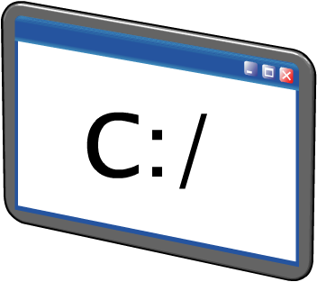
AD DS administracijski alati
Da bi upravljali AD DS objektima, možemo koristit isljedeće GUI alate:
Možemo koristit ii sljedeće CLI alate:
Active Directory Administration snap-inove
Active Directory Administrative Center
Windows PowerShell AD modul
Directory Service komande
Notes:
Consider demonstrating each tool as you discuss it.
20410B
3: Managing Active Directory Domain Services Objects

Slide 5
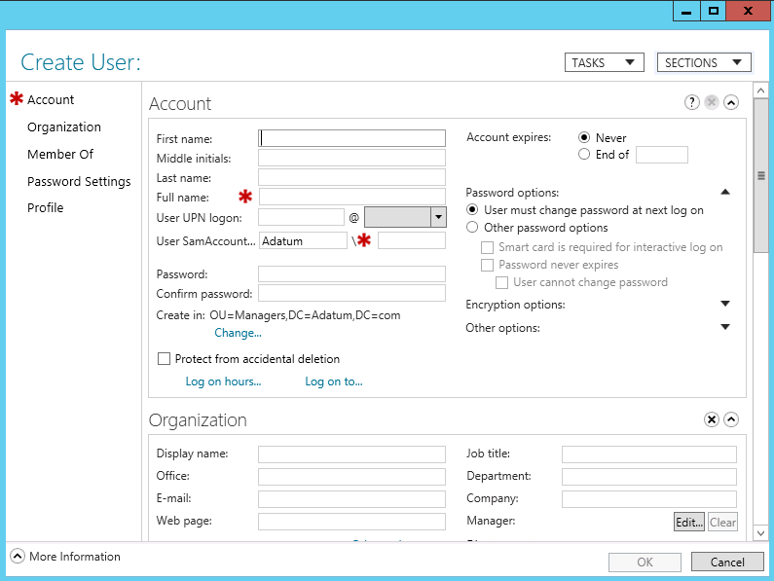
Kreiranje korisničkih računa
Notes:
Consider performing a demonstration of creating a user account, by using the steps that the student handbook provides.
Discussion Prompt
Ask your students about their user account naming strategies.
20410B
3: Managing Active Directory Domain Services Objects

Slide 6
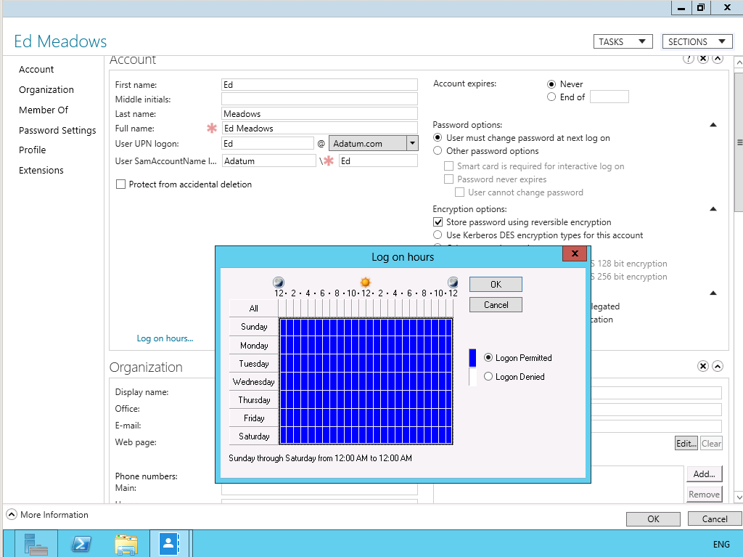
Konfiguriranje atributa
Notes:
Consider opening users’ accounts and viewing their account properties as you discuss this content with your students.
20410B
3: Managing Active Directory Domain Services Objects

Slide 7
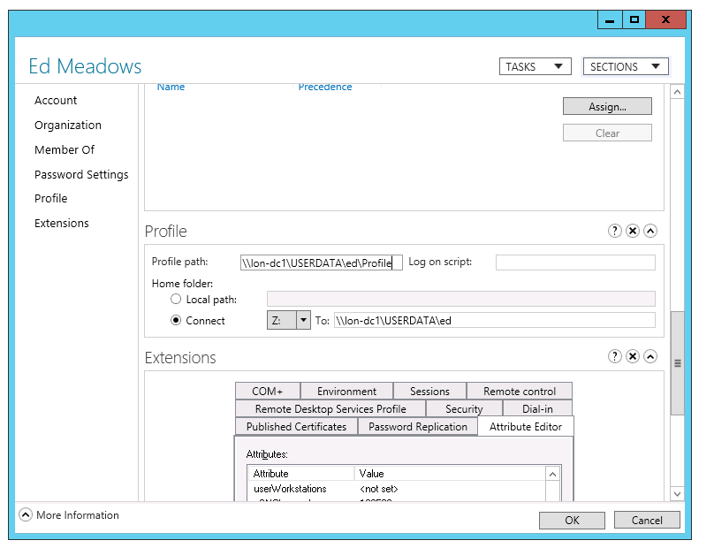
Kreiranje korisničkih profila
Notes:
Consider demonstrating this procedure while you discuss the content with your students.
20410B
3: Managing Active Directory Domain Services Objects

Slide 8
Upravljanje grupama
Tipovi grupa Doseg grupa Upravljanje grupama Defaultne Grupe Specijalni identiteti
Notes:
Some students that are new to Windows Server often have difficulty grasping the concept of groups within groups. Consider using your whiteboard for this lesson, and drawing three domains as triangles. Add a file resource to each domain, and then ask your students to consider how any file permissions would be required if each domain hosted 100 users that each needed access to the three file resources in your three domains. Then group the three sets of 100 users, and repeat the question. Then group the groups. This elegantly demonstrates the benefit of nesting groups. Now all you need to do is to explain the particulars of the types and scopes in Windows Server. As with lesson 1, consider making the demonstration the focus of this lesson.
20410B
3: Managing Active Directory Domain Services Objects

Slide 9


Tipovi grupa
Distribucijske grupe
Koriste se samo s e-mail aplikacijama
Nemaju SID i ne mogu im se dodjeljivati dozvole
Sigurnosne grupe
Sigurnosni principal s SID-om, mogu ime se dodjeljivati dozvole
Mogu se koristit i kao e-mail grupe
Notes:
You can use distribution groups to send messages to collections of users, but only with messaging applications such as Microsoft Exchange Server. Stress that distribution lists are not assigned a security identifier (SID), so they cannot be listed in discretionary access control lists (DACLs).
You use security groups to assign rights and permissions to groups of users and groups of computers. A security group is assigned a SID, which determines the permissions of a user whenever a user who is a member of a security group tries to access a network resource.
20410B
3: Managing Active Directory Domain Services Objects

Slide 10
Doseg grupa
Doseg grupe | Članovi iz iste domene | Članovi iz domene u istoj šumi | Članovi iz vanjske domene kojoj vjerujemo | Mogu imati dozvole na resurse
Local | U, C, GG, DLG, UG i lokalni korisnici | U, C, GG, UG | U, C, GG | Samo na lokalnom kompjuteru
Domain Local | U, C, GG, DLG, UG | U, C, GG, UG | U, C, GG | Bilo gdje u domeni
Universal | U, C, GG, UG | U, C, GG, UG | N/A | Bilo gdje u šumi
Global | U, C, GG | N/A | N/A | Bilo gdje u domeni ili domeni kojoj vjerujemo
U User C Computer GG Global Group DLG Domain Local Group UG Universal Group
Notes:
Use the table to describe group scopes. Consider drawing a diagram with several domains that shows where you can create groups, and the implications of each group scope.
20410B
3: Managing Active Directory Domain Services Objects

Slide 11






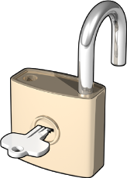
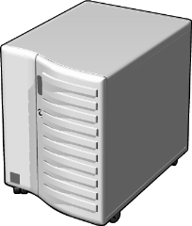

Upravljanje grupama
I
Identiteti
Korisnici ili kompjuteri
koji su članovi
G
Global groups
Koji grupiraju članove prema ulogama,
Sales
(Global Group)
koje su članovi
Auditors (Global Group)
DL
Domain local groups
Koji omogućavaju dozvole za pristup
resursima, koje su
ACL_Sales_Read (Domain Local Group)
A
Dodijeljene resursima
U šumi s više domena, koristi se IGUDLA, gdje U predstavlja Universal
Notes:
Use this animated slide to explain the example in the student notes. You will need to click four times to see all the stages in this slide, which are:
Identities
Global groups
Domain local groups
Assigned resource access
Alternatively, draw an illustration on the whiteboard by using the following guidelines to illustrate the advantage of group nesting:
1. Draw three domain objects, each containing five users. Draw a file object in one of the three domains.
Question: How many file permissions would you need to create to assign permissions on this file for each user?
Answer: You would need to create fifteen file permissions.
2. Draw a circle around the five users in each domain, explaining that the circles represent global groups.
Question: How many permissions on the file would you need to assign at the global group level?
Answer: You would need to assign three permissions.
3. Draw a circle adjacent to the file. Draw arrows from your global groups to this circle, indicating that you have added these groups to a local group in the resource holding domain.
Question: How many permissions must you assign to the local group?
Answer: You must assign one permission to the local group.
20410B
3: Managing Active Directory Domain Services Objects

Slide 12
Defaultne Grupe
Oprezno upravljajmo članstvom u defaultnim grupama jer one :
Obično daju veće dozvole nego su potrebne za većinu okolina gdje se dio dozvola delegira drugim korisnicima
Često štite svoje članove od nekih postavki
Grupa | Lokacija
Enterprise Admins | Users kontejner u korijenskoj domeni šume
Schema Admins | Users kontejner u korijenskoj domeni šume
Administrators | Built-in kontejner svake domene
Domain Admins | Users kontejner svake domene
Server Operators | Built-in kontejner svake domene
Account Operators | Built-in kontejner svake domene
Backup Operators | Built-in kontejner svake domene
Print Operators | Built-in kontejner svake domene
Notes:
Show your students the groups mentioned on the slide as you discuss them.
20410B
3: Managing Active Directory Domain Services Objects

Slide 13
Specijalni Identiteti
Specijalni identiteti:
Su grupe čijim članstvom upravlja operativni sustav
Mogu se koristit da bi omogućili pristup resursima:
Ovisno o autentifikaciji ili tipu veze
Ne bazirano prema korisničkim računima
Bitni specijalni identiteti:
Anonymous Logon
Authenticated Users
Everyone
Interactive
Network
Notes:
Show your students the groups that are mentioned on the slide, as you discuss them.
20410B
3: Managing Active Directory Domain Services Objects

Slide 14
Upravljanje kompjuterskim računima
Što je Computers kontejner? Definiranje lokacije kompjuterskih računa Kontroliranje dozvola za kreiranje kompjuterskih računa Kompjuterski računi i sigurna komunikacija Resetiranje sigurne komunikacije
Notes:
There are no demonstrations within this lesson. As you work your way through the content, consider performing small, impromptu demonstrations to help reinforce the content.
20410B
3: Managing Active Directory Domain Services Objects

Slide 15
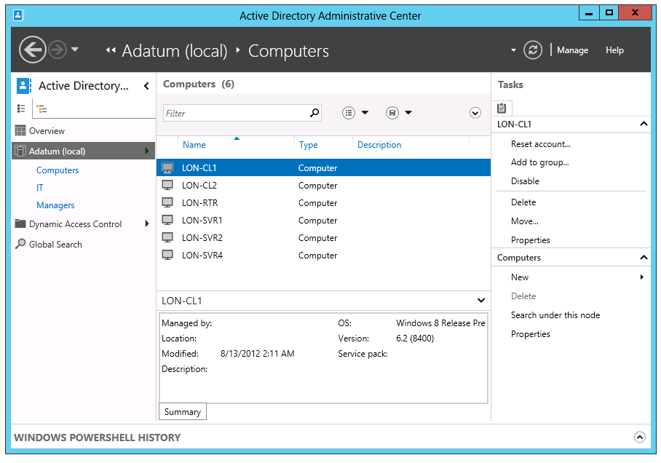
Što je Computers kontejner?
Notes:
Consider opening Active Directory Users and Computers or Active Directory Administrative Center and demonstrating the default location for computer objects.
20410B
3: Managing Active Directory Domain Services Objects

Slide 16
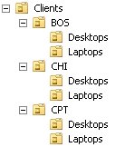
Definiranje lokacije kompjuterskih računa
Preporuka je kreiranje OU za kompjuterske objekte
Serveri
Obično podijeljeni prema serverskim ulogama
Klijenti
Obično podijeljeni prema regiji
Podjela OU:
Prema administraciji
Pojednostavljivane implementacije
Group Policy postavki
Notes:
Emphasize the best practice of creating custom OUs for computer objects, rather than relying on the default Computers container.
Help students understand just enough about delegation (assigning permissions to OUs) and about configuration (linking GPOs to OUs) to understand how they might choose to design OU branches for clients and servers. Later modules go into more detail about Group Policy and delegation, and their impact on OU design. Do not go into too much detail here, but rather use the opportunity to introduce students to these concepts.
20410B
3: Managing Active Directory Domain Services Objects

Slide 17
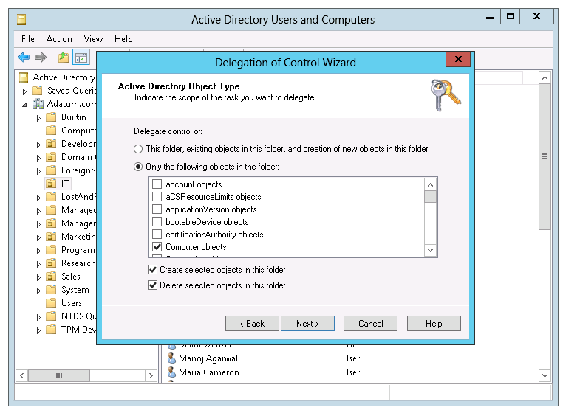
Kontroliranje dozvola za kreiranje kompjuterskih računa
Notes:
Consider demonstrating the process of delegating control over computer creation and deletion.
20410B
3: Managing Active Directory Domain Services Objects

Slide 18
Kompjuterski računi i sigurna komunikacija
Kompjuteri imaju svoje račune
sAMAccountName i lozinku
Koriste se za kreiranje sigurne veze između kompjutera i domenskog kontrolera
Scenariji kada je sigurna veza prekinuta
Reinstalacija kompjutera čak s istim imenom generira novi SID i novi objekt u AD bazi
Povrat kompjutera iz sigurnosne kopije ili primjena snapshota
Kompjuter i domenski kontroler se ne slažu oko lozinke
Notes:
Explain to students that the secure channel between a computer and a domain controller is used for all communication with the domain, including authentication of a user logon to the computer. The secure channel is established when the computer authenticates to the domain by using its user name and password. Like users, computers have logon names and passwords. If the computer is unable to log on successfully, the secure channel is not established. The effect is similar to when a user enters the wrong user name or password. In both circumstances, the user is not able to authenticate to the domain.
There are several scenarios during which the secure channel can be broken. Three of them are listed on the slide.
What is not listed on the slide is Administrator errors in AD DS. These can include dangerous Active Directory actions, such as rolling back a domain controller that is running a snapshot. You should mention that there are several ways for an administrator to damage AD DS (manually, automatically, intentionally, or accidentally), and damage might become apparent with broken secure channels.
Discussion Prompt
Ask students:
What scenarios have you encountered in which you identified that the secure channel was broken?
How did you know the secure channel was broken?
After students have shared their experiences, ask the question a slightly different way:
What scenarios have caused you to remove a computer from the domain, and then rejoin it to the domain?
This is a very common technique that administrators use to reset a secure channel. They often do not realize what they are actually doing when they remove the computer and then rejoin the domain.
If students have not already mentioned the logon message that states, “The trust relationship between the workstation and the primary domain failed,” ask the students the following question:
Have you ever tried to log on to the domain and received a message telling you that the computer could not talk to the domain? What messages did you receive?
Help students delineate messages such as “A domain controller is not available,” which is typically the result of networking connectivity problems, from messages that mention trust with the domain or otherwise indicate problems with the secure channel.
With these setups, move on to the next slide.
20410B
3: Managing Active Directory Domain Services Objects

Slide 19
Resetiranje sigurne komunikacije
Nemojte micati kompjuter objekt iz domene i raditi rejoin na kompjuteru
Ovaj proces kreira novi kompjuterski objekt na domeni i dodjeljuje mu novi SID
Opcije za resetiranje sigurne komunikacije:
Active Directory Users and Computers
DSMod.exe
NetDom.exe
NLTest.exe
Windows PowerShell
Notes:
A broken computer account manifests itself with a variety of symptoms, error messages, and event‑log entries.
Mention that a user might be able to log on to a machine with a broken secure channel using cached credentials, but they will experience other strange behavior, because authentication cannot use Kerberos version 5 (V5) protocol without a functioning secure channel.
Because NLTest.exe and NetDom.exe reset the secure channel without requiring a reboot, you should try those commands first. Only if you are not successful should you use the Reset Account command or DSMod.exe to reset the computer account.
Resetting the secure channel requires the Reset Password permission on the computer object.
20410B
3: Managing Active Directory Domain Services Objects

Slide 20
Kratak pregled domenskih kontrolera
Što je domenski kontroler? Što je Global katalog? AD DS proces prijave na domenu Što su Operations Masters?
Notes:
This lesson describes the purpose of domain controllers and introduces the concept of the global catalog. It also describes in detail the logon process. This lesson covers the importance of DNS, particularly service resource (SRV) records, to the logon process. It also examines various operations master roles and how they contribute to the functioning of the AD DS domain.
Question
Why would you make a domain controller a global catalog server?
Answer
Queries that are directed at the forest (rather than the domain) need to be directed to a global catalog server. This is because a domain controller that is not a global catalog only holds information about the objects in its own domain. As a best practice, you should configure every domain controller to be a global catalog, even in a single domain forest.
20410B
2: Introduction to Active Directory Domain Services

Slide 21
Što je domenski kontroler?
Domenski kontroleri
Služe kao poslužitelji na kojima se nalazi AD DS baza (NTDS.DIT) i SYSVOL
Kerberos i KDC servisi odrađuju autentifikaciju
Preporuke:
Visoka dostupnost: Barem dva domenska kontrolera za svaku domenu
Sigurnost: RODC i BitLocker
Notes:
Emphasize to students that the database and services are stored on servers called domain controllers.
Domain controllers—servers that perform the AD DS role—host the Active Directory database, SYSVOL, the Kerberos authentication service and other Active Directory services. For redundancy purposes, it is best to have at least two available domain controllers.
Highlight that all domain controllers in a domain essentially are equal. Each domain controller contains a copy of the directory store, and updates can be made to the AD DS data on all domain controllers except for RODCs.
Emphasize the importance of having multiple domain controllers in each domain. This provides load balancing, but more importantly, it also provides recoverability if a server failure occurs.
Mention that all domain controllers engage in authentication and authorization, thus making it a redundant system with fewer fail points.
This topic does not provide much information about best practices. If students are interested, you can go into more detail about installing domain controllers in remote sites to protect against an unavailable wide area network (WAN) connection. You can also talk about increasing the number of domain controllers to account for redundancy and performance.
20410B
2: Introduction to Active Directory Domain Services

Slide 22





Što je Global katalog?
Shema
Global katalog:
Sadrži parcijalne informacije o svim objektima u šumi Omogućava upite o svim objektima u šumi
Configuration
Domain A
Shema
Konfiguracija
Domena A
Shema
Konfiguracija
Domena B
Domena B
Global katalog poslužitelj
Shema
Konfiguracija
Domena B
Notes:
Describe the role of the global catalog server when searching for objects across domains in a forest. Define a global catalog as a domain controller that replicates the partial attribute set for each domain in the forest. The domain controller does not need the partial attribute set for its own domain because it already has the full copy of the domain database, and only needs the changes made to other domains. That is why, in a single domain environment, making every domain controller a global catalog server adds no significant replication.
Question
Should a domain controller be a global catalog?
Answer
Every domain controller should be a global catalog. (In some extreme situations, there might be a reason not to do so.) However, most large, distributed organizations are doing just that, so it also makes sense for less complex, smaller organizations.
20410B
2: Introduction to Active Directory Domain Services

Slide 23




AD DS proces prijave na domenu
Proces prijave na AD DS:
Korisnički račun se autentificira na DC1
DC1 vraća TGT klijentu
Klijent koriti TGT za pristup na RS1
DC1 dozvoljava pristup na RS1
Klijent koristi TGT za pristup na SVR1
DC1 vraća pristup na SVR1
DC1
RS1
SVR1
Notes:
Use this slide to illustrate how the logon process works.
In the first phase, the user account is authenticated to DC1.
In the second phase, the user account applies to the domain controller for a ticket to gain authorization to connect with the local computer.
A centralized directory service such as AD DS provides a single identity store, authentication service, and point of management for administration.
Emphasize the advantages of a single identity store for security and manageability.
20410B
2: Introduction to Active Directory Domain Services

Slide 24
Što su Operations Masters?
U multimaster replikacijskoj topologiji neke uloge moraju biti samo na jednom domenskom kontroleru
Mnoga imena se koriste za ove uloge a među ostalima najčešća su:
Operations master (ili operations master uloge)
Single master roles
FSMO
Uloge
Domena:
RID master
Infrastructure master
PDC Emulator master
Šuma:
Domain naming master
Schema master
Notes:
Discuss each of the operations master roles in as much depth as you feel is appropriate for the students.
Be sure to point out that most master roles are so specific that the master could be offline for a while without causing any problems. For example, you do not need the schema master until you make changes to the schema, and you do not need the domain naming master until you add or remove a domain in the forest.
Point out that other domain services can be slowed or disrupted if a domain controller is offline and not available. Be sure to point out to students that these roles all run on a domain controller, so the loss of a domain controller could cause serious problems.
Domain Flexible Single Master Operations (FSMOs) are needed on a more regular basis than those in the forest root domain, particularly the primary domain controller (PDC) emulator.
The relative ID (RID) master provides a pool of RIDs to each domain controller. If this master is not available, eventually a domain controller will attempt to create an account and will be unable to do so.
Talk through the five PDC functions to the level of detail that is provided in the student handbook. Enforce that if the PDC emulator master is not available or is slow to respond, you are more likely to have issues in the domain.
You can find which domain controllers are FSMO holders by typing the following at a command prompt, and then pressing Enter:
Netdom query fsmo
20410B
2: Introduction to Active Directory Domain Services

Slide 25
Instalacija domenskog kontrolera
Instalacija domenskog kontrolera iz Server Manager konzole Instalacija domenskog kontrolera na Core instalaciji operativnog sustava Nadogradnja domenskog kontrolera Instalacija domenskog kontrolera korištenjem Install from Media opcije
Notes:
Depending on the students’ experience with AD DS, you might have to explain in more detail the implications of no longer being able to run the dcpromo.exe tool as a GUI wizard. This tool is only used in Windows Server 2012 for an unattended installation. Mention to students that you can remotely promote a server to be a domain controller by using Server Manager running on Windows Server 2012.
Emphasize to the students that this module is only concerned with installing domain controllers by using the GUI tools. There are other ways of installing domain controllers by using scripting tools such as Windows PowerShell® or VBScript.
Question
What is the reason to specify the Directory Services Restore Mode password?
Answer
If the AD DS database must be restored from backup, the domain controller must be restarted into Directory Services Restore Mode. You then must use the Directory Services Restore Mode password to log on to the domain controller when it starts in Directory Services Restore Mode.
20410B
2: Introduction to Active Directory Domain Services

Slide 26
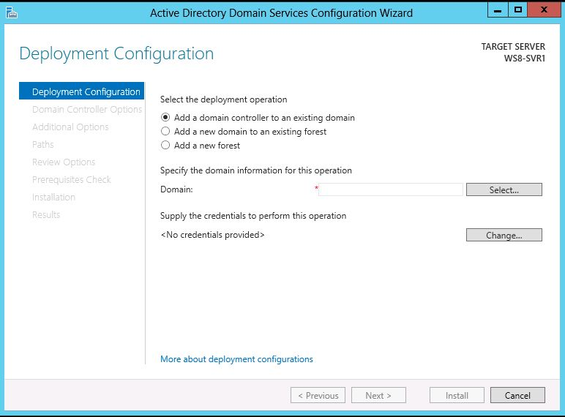
Instalacija domenskog kontrolera iz Server Manager konzole
Notes:
Use Server Manager to run through the initial process of installing an AD DS domain controller. Show the option to choose the local server or a remote server from the server pool. Explain that the initial pass installs the binaries for AD DS, and then you can continue to configure the AD DS installation.
20410B
2: Introduction to Active Directory Domain Services

Slide 27
Instalacija domenskog kontrolera na Core instalaciji operativnog sustava
Pomoću dcpromo /unattend:”D:\answerfile.txt” komande pokrenemo automatiziranu instalaciju. Ispod vidimo primjer tekstualne datoteke za automatizaciju instalacije:
[DCINSTALL]
UserName=<Administratorski korisnički račun>
UserDomain=<Ime domene u kojoj se nalazi Administratorski korisnik>
Password=<Lozinka za UserName račun>
SiteName=<Ime fizičke lokacije domenskog kontrolera> Lokacija mora biti unaprijed kreirana u Dssites.msc konzoli.
ReplicaOrNewDomain=replica
ReplicaDomainDNSName=<Fully qualified domain name (FQDN) domene u koju dodajemo dodatni domenski kontroler>
DatabasePath="<Lokacija baze na lokalnom disku>"
LogPath="< Lokacija baze na lokalnom disku >"
SYSVOLPath="< Lokacija baze na lokalnom disku >"
InstallDNS=yes
ConfirmGC=yes
SafeModeAdminPassword=<Lozinka za DSRM administratorski račun>
RebootOnCompletion=yes
Notes:
Describe the command displayed on the slide, and refer to the answer file (answerfile.txt). Remind the students that dcpromo.exe cannot be used in GUI format in Windows Server 2012, but can still be typed at a command prompt when doing an unattended install.
20410B
2: Introduction to Active Directory Domain Services

Slide 28
Nadogradnja domenskog kontrolera
Opcije nadogradnji AD DS na Windows Server 2012:
Direktna nadogradnja (in place) (s Windows Servera 2008 ili Windows Servera 2008 R2)
Prednosti: Osim provjere kompatibilnosti, sve aplikacije i programi ostaju gdje su i bili i nema potrebe za ponovnom instalacijom
Pripaziti na: Mogu ostati stare datoteke i DLL-ovi
Novi Windows Server 2012 u domeni i promoviranje u domenski kontroler
Ovo je preporučeni način instalacije
Prednosti: Novi poslužitelj bez starih datoteka, DLL-ova ili konfiguracija
Pripaziti na: Trebat će vremena za migraciju podataka i aplikacija
Notes:
20410B
2: Introduction to Active Directory Domain Services

Slide 29
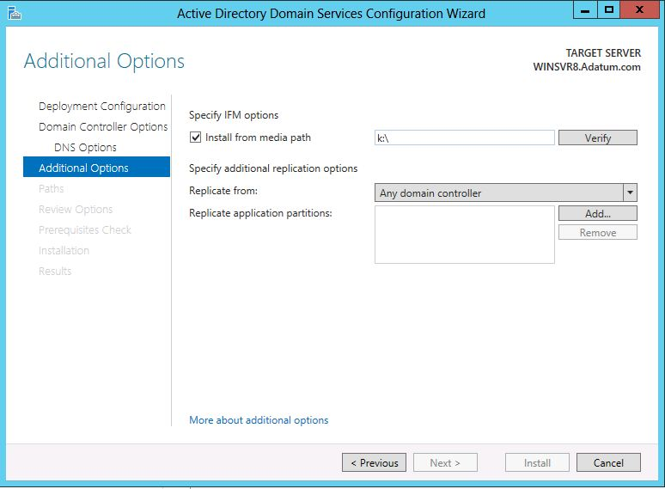
Instalacija domenskog kontrolera korištenjem Install from Media opcije
Notes:
Point out to students that because they are installing the domain controller using the IFM method, they should select the Install from media path check box. The next step is to type the path to the snapshot file in the Install from media path box.
20410B
2: Introduction to Active Directory Domain Services

Slide 30
Uvod u Group Policy
Upravljanje konfiguracijama Kratko o Group Policies Prednosti korištenja Group Policy Group Policy Objects GPO doseg Group Policy Client i Client-Side Extensions
Notes:
Note: You may find that some students are familiar with some of this content, particularly those who have recently attended course 20410A. If this is the case, then use the lesson as a review.
In this lesson, you will provide an overview of Group Policy. The goal of this lesson is to introduce the core concepts, terms, and components of Group Policy, so that students have a big-picture understanding of Group Policy. They must see the overview, and have a feeling for the pieces and how they fit together.
Do not go into too much detail about any one concept, term, or component. Remaining lessons in this module provide greater detail about each concept, term, and component.
We highly recommend that you read the text in the student handbook for this lesson, and use that text as a guide or even as a script for delivering this module. The text provides just enough detail to get students on the same page, regardless of their previous experience levels.
We also highly recommended that, rather than stepping through slides, you demonstrate as much as possible live in the user interface as you discuss policy settings, GPOs, and GPO links. Again, the text in the student handbook provides a guide for this demonstration. You can use the policy setting that restricts access to the registry tools, and then follow that through a GPO, linking the GPO to an organizational unit (OU), and then perhaps even showing the results of the GPO on a client.
Demonstration
Consider starting the lesson with the demonstration “How to create a GPO and Configure GPO Settings” that appears at the end of this lesson. Use that as the basis for talking through the content on this lesson’s topics.
20411B
5: Implementing a Group Policy Infrastructure

Slide 31
Upravljanje konfiguracijama
Upravljanje konfiguracijama je centralizirani pristup primjeni jedne ili više promjena na jednog ili više korisnika ili računala
Ključni elementi upravljanja konfiguracijama su:
Postavke
Doseg
Primjena
Notes:
Because there are so many components within Group Policy, it is helpful to start by taking a step back from the technology, and making sure that students understand the broad concept and business value of configuration management.
By presenting configuration management as three elements—setting, scope, and application—you create a framework in students’ minds for understanding the role of each Group Policy component.
Explain that configuration management, and Group Policy in particular, enables information technology (IT) administrators to automate the management of users and computers. This simplifies administrative tasks and reduces IT costs. Administrators can implement security settings, enforce IT policies, and distribute software consistently for the local computer or across a given site, domain, or range of OUs.
The Information Assurance topic that builds the case for GPO usage is configuration management. This is an industry best practice that requires emphasis. Resultant Set of Policy (RSoP) also is good documentation for the standardization of computers and user accounts. Furthermore, this is a good place to mention the how an organization’s security posture improves with the use of effective Group Policy. GPOs also are a method for mitigating the risk associated with specific security threats that organizations face.
20411B
5: Implementing a Group Policy Infrastructure

Slide 32
Kratko o Group Policies
Najgranularnija komponenta Group Policy je poznata kao ‘policy’ i definira specifičnu konfiguracijsku promjenu
Policy postavka može imati tri stanja:
Not Configured
Enabled
Disabled
Mnoge policy postavke su kompleksne, i efekt uključivanja ili isključivanje ne mora odmah biti sam po sebi jasan
Notes:
Consider demonstrating the Group Policy Management Editor on LON-DC1 while you discuss this and subsequent topics.
20411B
5: Implementing a Group Policy Infrastructure

Slide 33
Prednosti korištenja Group Policy
Group Policies su jak administrativni alat. Možemo ih koristiti za primjenu različitih tipova postavki na velik broj korisnika ili računala
GPO se najčešće koriste na sljedeći način:
Primjena sigurnosnih postavki
Upravljanje postavkama desktop aplikacija
Instalacija softvera
Preusmjeravanje direktorija
Podešavanje mrežnih postavki
Notes:
Consider demonstrating some of the settings that the slide lists.
20411B
5: Implementing a Group Policy Infrastructure

Slide 34
Group Policy Objects
GPO je:
Kontejner ja jednu ili više policy postavki
Upravljamo pomoću GPMC
Sprema se u GPO kontejner
Modificira se pomoću GPME
Primjenjuje se na specifičnu točku u hijerarhiji AD-a
Notes:
Consider demonstrating each point in the slide to help to reinforce student understanding.
20411B
5: Implementing a Group Policy Infrastructure

Slide 35
GPO doseg
Doseg GPO je skup korisnika i računala koji će primijeniti postavke tog GPO. Doseg GPO možemo kontrolirati na nekoliko načina:
Postaviti GPO na kontejner, na primjer neki OU
Filtriranjem sigurnosnih postavki
Filtriranje korištenjem WMI filtera
Notes:
Mention that a GPO, and all of the settings that it contains, does not take effect until you have defined its scope. The first step to scoping a GPO is linking it to a site, domain, or OU. Introduce students to the mnemonic, Site-Domain-OU (SDOU).
Stress that GPOs apply to users and computers only, and not to groups, despite the Group Policy name.
If you choose to demonstrate the slide, create a new GPO, and then link it to the domain.
Emphasize the idea that the link or links define the maximum scope of the GPO.
Discussion Prompt
Pose a question: What if you do not want the GPO settings to apply to all objects within the scope?
Use the question to transition to the concept of security group filtering, emphasizing that such filtering creates a subset of objects within the broader scope of the GPO link.
Important Note:
Many experienced students rely too heavily on GPO links to manage the scope of GPOs. This often leads to less-than-ideal design of Active Directory® Domain Services (AD DS) OUs, at the expense of efficiently applied and managed security, such as access control lists (ACLs) and delegation.
Continue with a very brief discussion of Windows Management Instrumentation (WMI) filtering, keeping the discussion at a very high level. Use the example of a policy setting that you want to apply to only a certain operating system. Define WMI filtering as a way of querying the system and then determining whether to apply a GPO.
Wrap up with a mention of preferences targeting. The goal is simply to introduce the term, and to prepare students for the idea that it is possible, now, to apply only part of a GPO to clients as long as that part is part of preferences.
20411B
5: Implementing a Group Policy Infrastructure

Slide 36
Group Policy Client i Client-Side Extensions
Group Policy klijent dohvaća GPO
Klijent skida i privremeno sprema GPO
CSE procesiraju postavke
Policy postavke u Computer Configuration čvoru se primjenjuju prilikom pokretanja računala i svakih 90–120 minuta nakon toga
User Configuration policy postavke se primjenjuju prilikom prijave korisnika na računalo i svakih 90–120 minuta nakon toga
Notes:
Use this topic to introduce the concept that Group Policy is applied using client-side (pull) processes. Introduce students to the idea that there are two major phases to application. First, the Group Policy Client asks AD DS which GPOs to apply. Then, enhanced GPOs go to the client-side extensions, which actually apply the settings.
Present the fact that most client-side extensions (CSEs) apply settings only if the GPO has changed, in order to improve performance by not needlessly reapplying the same settings repeatedly.
You optionally may choose to discuss the Always Wait For Network At Startup And Logon policy setting as you discuss Group Policy refresh and application. Information about this setting is presented in the student handbook.
20411B
5: Implementing a Group Policy Infrastructure

Slide 37
?

